Slide 1
My web design
Luke Davis

Slide 2

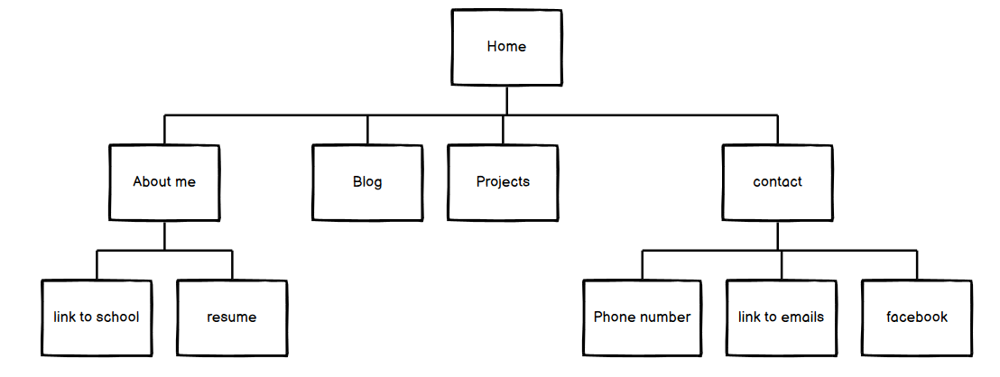
Site Map

Slide 3
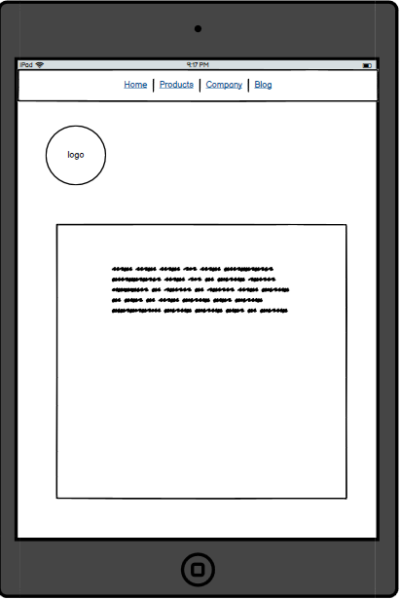
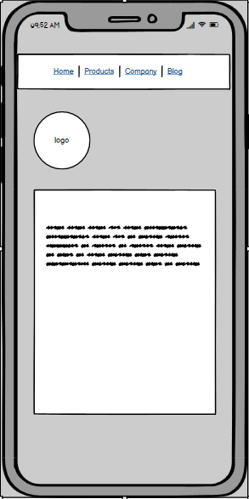
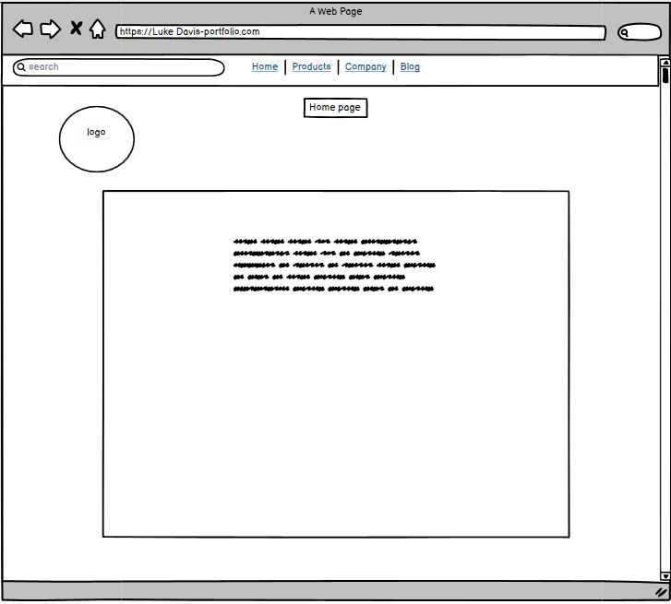
Home page/ wireframes

Slide 4
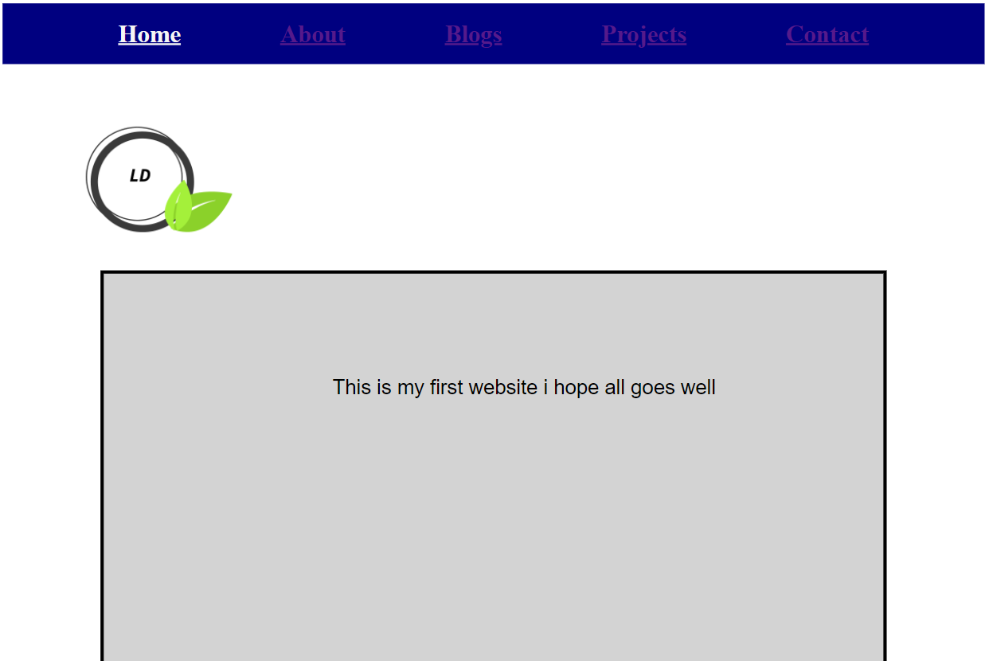
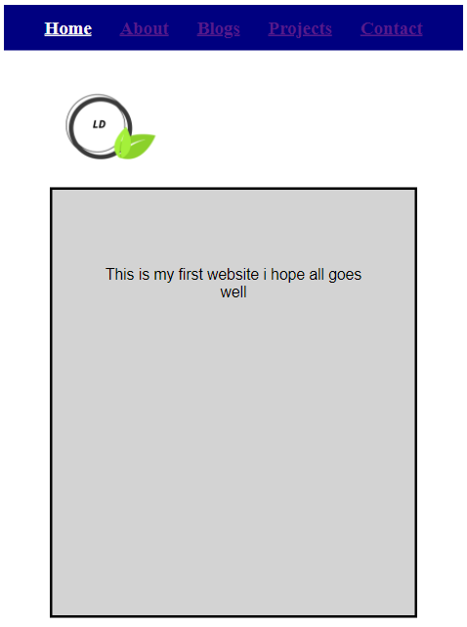
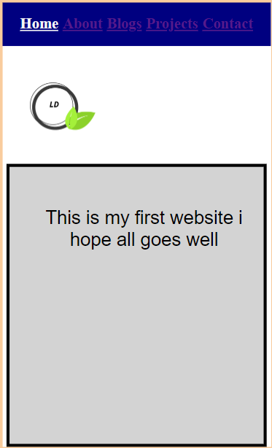
Home Page/ Web

Slide 5
Decision making/ Features
The home page design
Super simplistic design
The layout
Basic colors and backgrounds
Why I chose the layout
Easy to fix and move around
Nothing intriguing

Slide 6
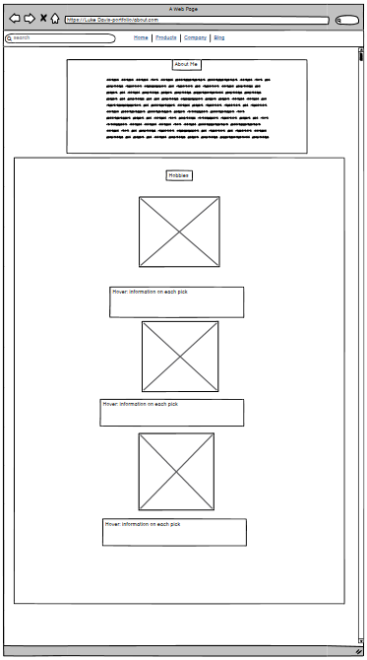
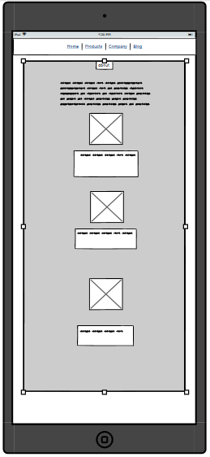
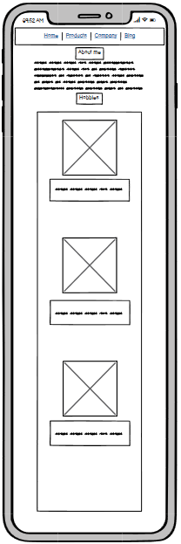
About Page/Wireframes

Slide 7
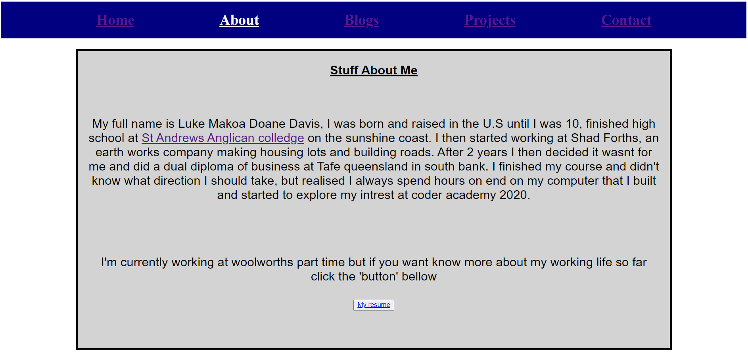
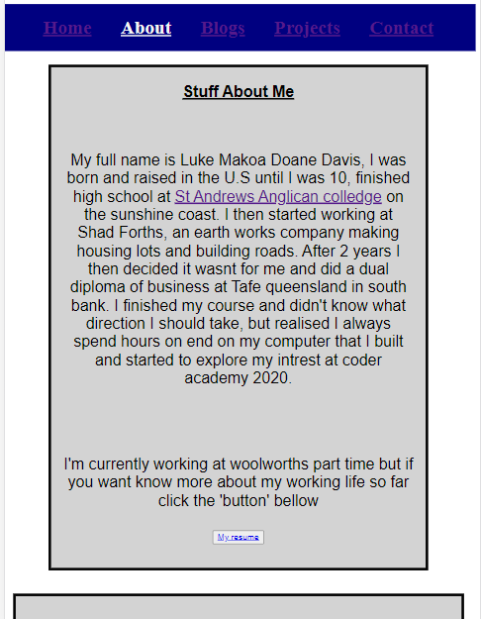
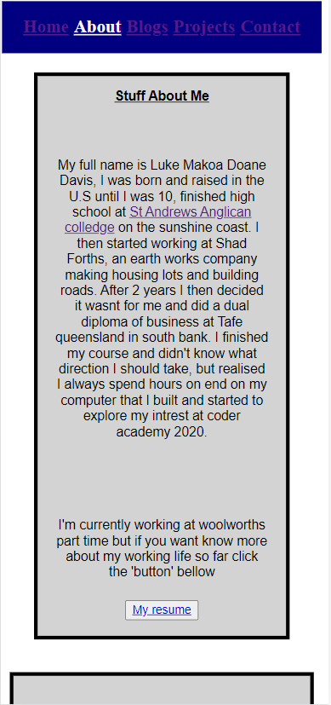
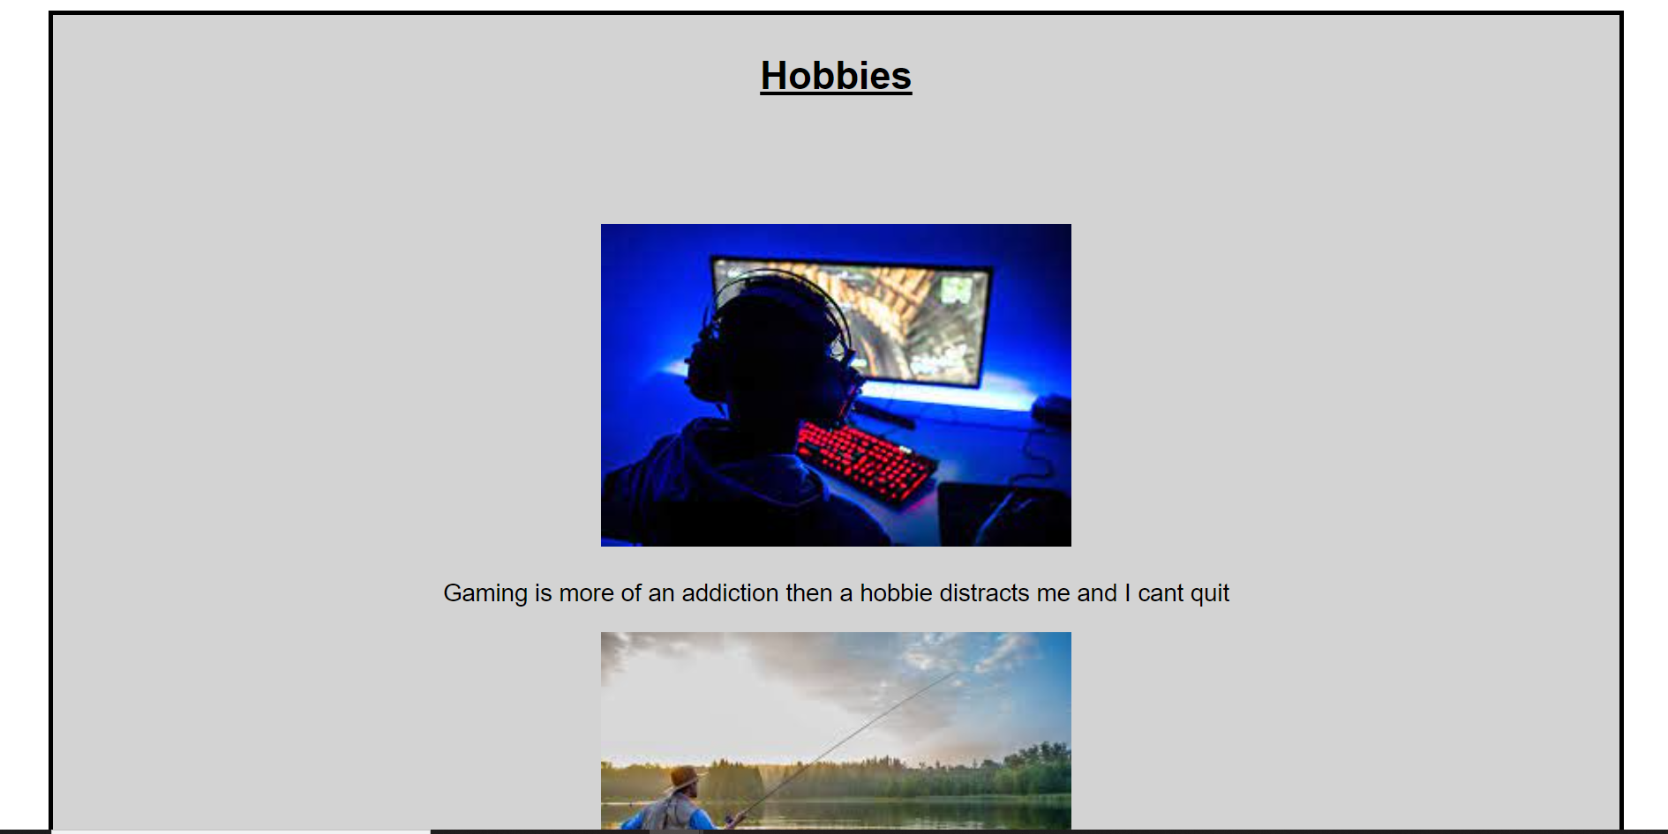
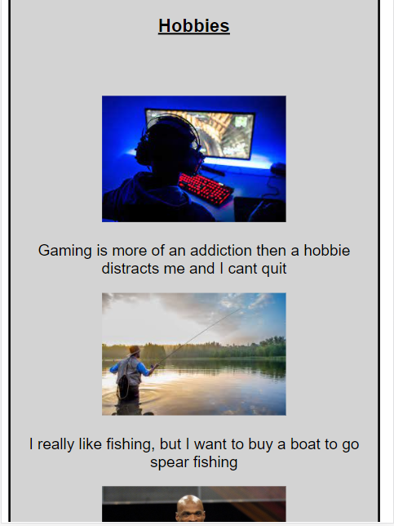
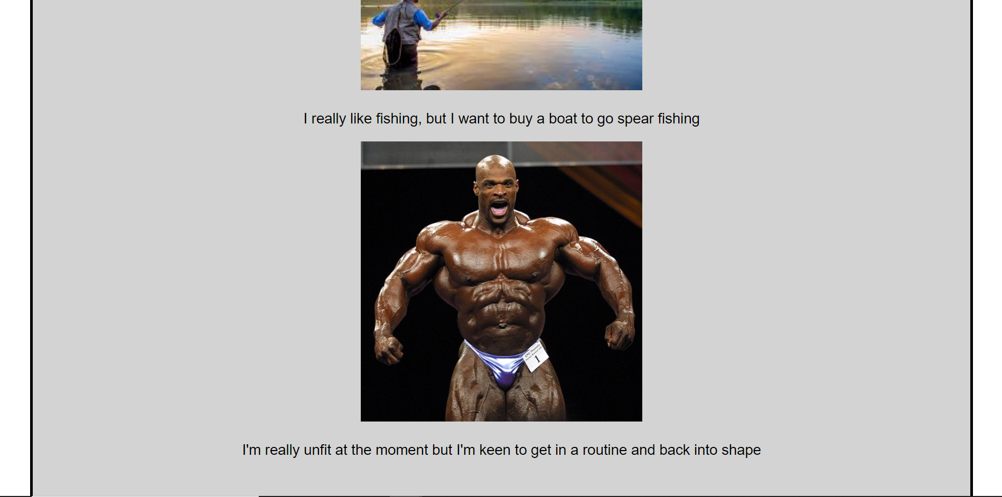
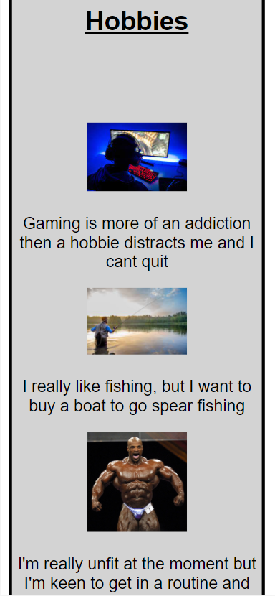
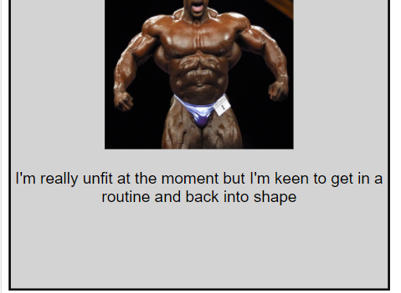
About Page/Web

Slide 8
Decision making/ Features
The About page design
Separate borders
The layout
Centered
Why I chose the layout
Easy to make changes and responsiveness
Any interesting features
A tag link to my high school and button for my resume
What makes the web intriguing or engaging
Separating the borders make a little better looking

Slide 9
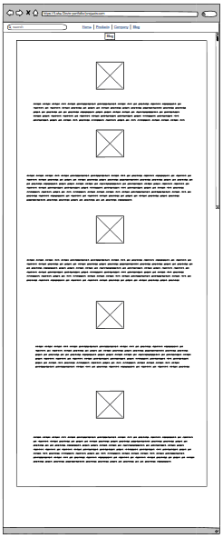
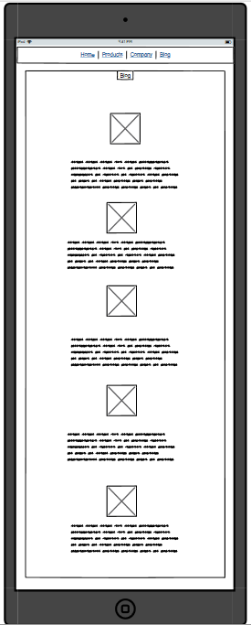
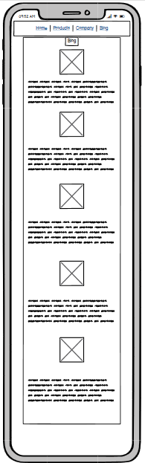
Blog Page/ Wireframes

Slide 10

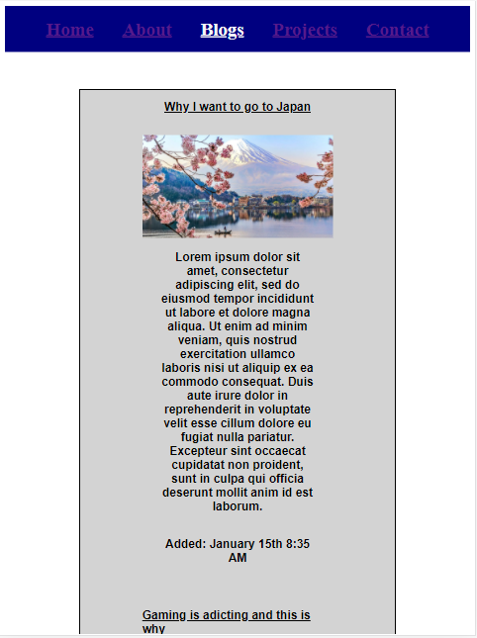
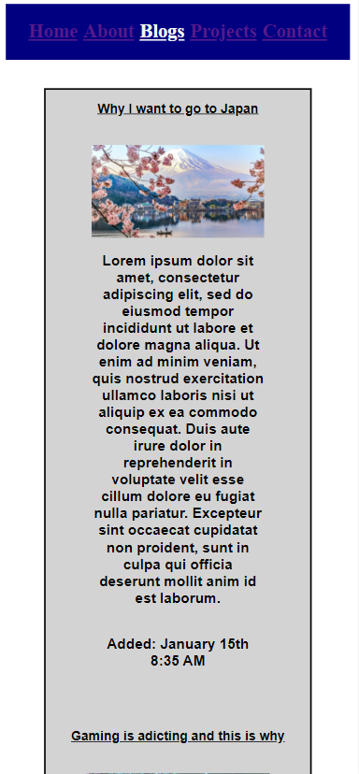
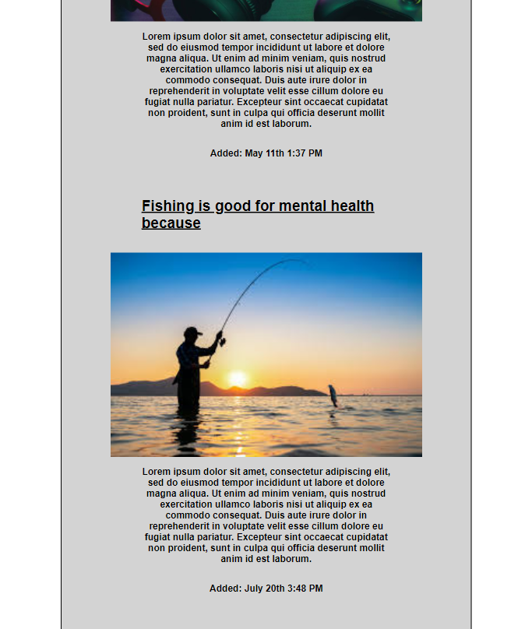
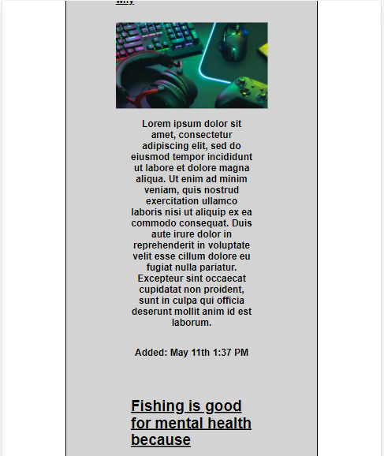
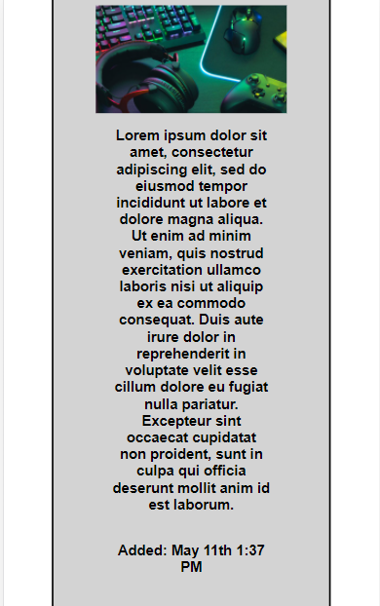
Blog Page/ Web

Slide 11
Decision making/ Features
The Blog page design
One border wide layout big images
Why I chose the layout
Easy for my website to expand and shrink with as few problems as possible
Any interesting features
Really don’t have any engaging or interesting features besides the large images
to keep the viewer engaged

Slide 12
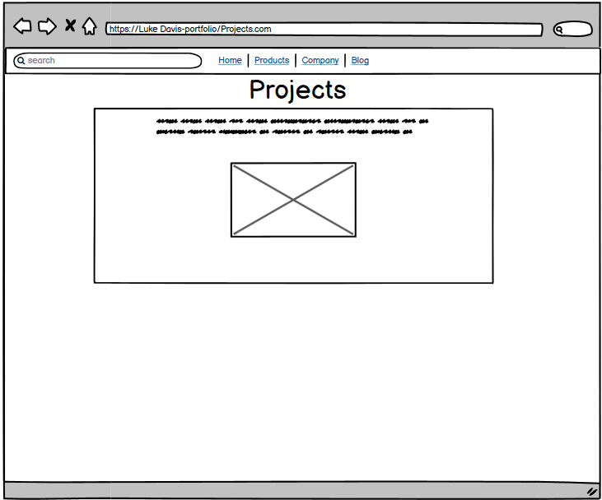
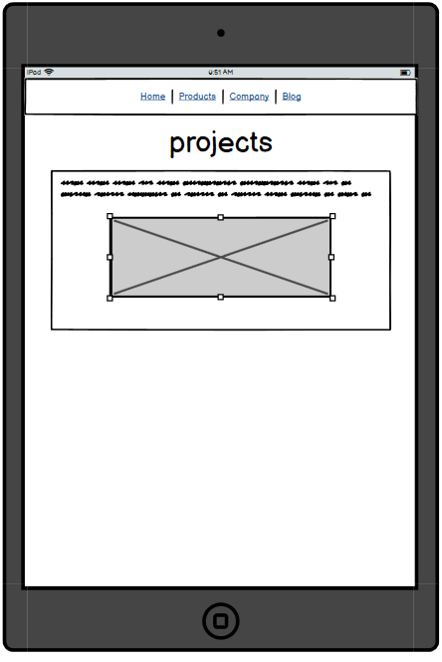
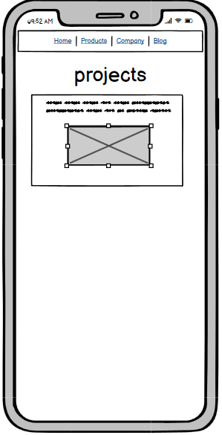
Projects Page/ Wireframes

Slide 13
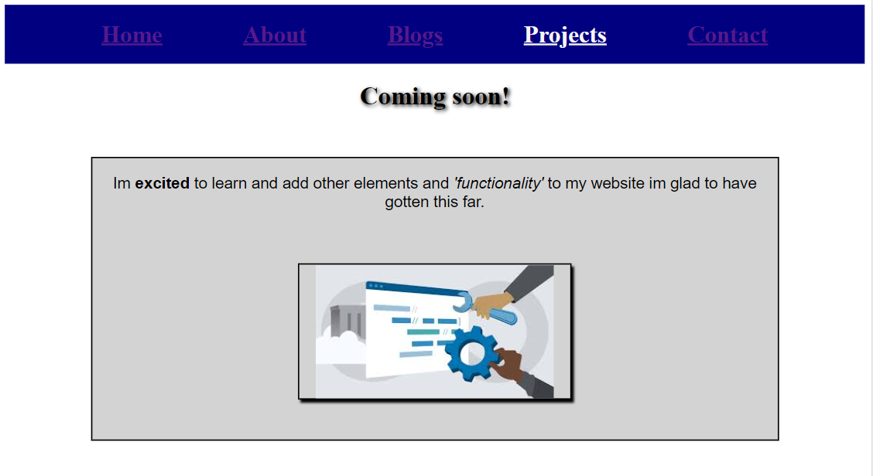
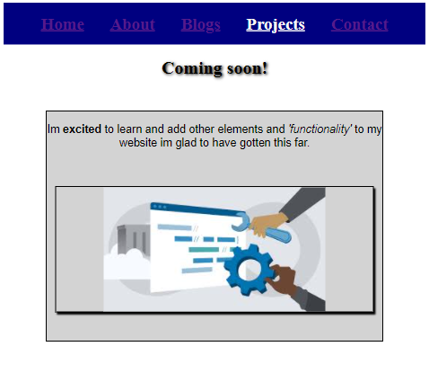
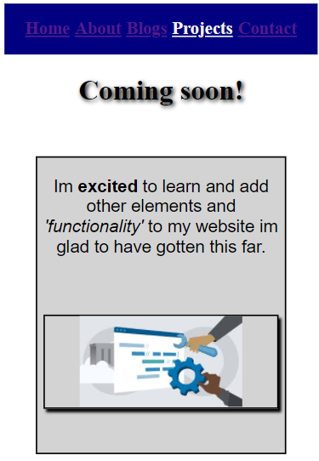
Projects Page/ Web

Slide 14
Decision making/ Features
The projects page design
Same as the rest keep it simple
Why I chose the layout
Just matching the rest of my design easy to fix
Any interesting features
Added shadows and inline styles to the words ‘excited’ and ‘functionality’
What makes the web intriguing or engaging
Additional styles to the rest of the site inline and scss

Slide 15
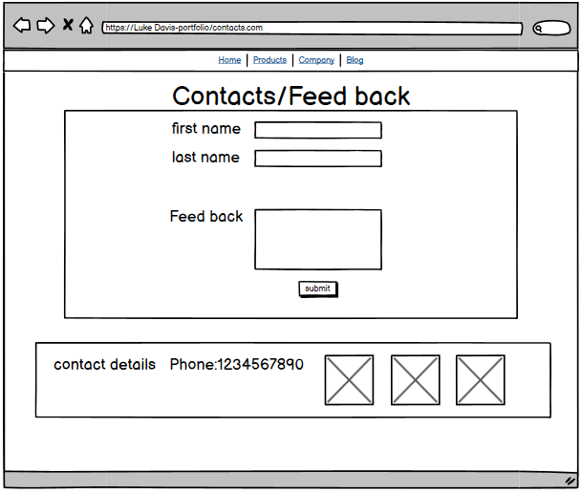
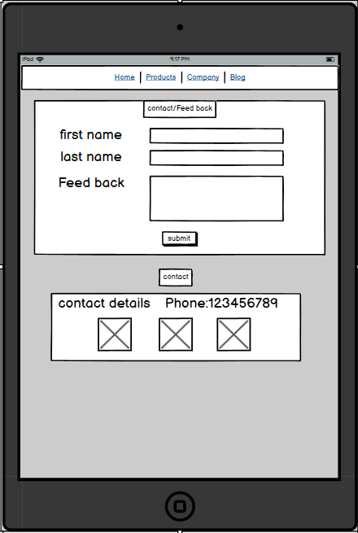
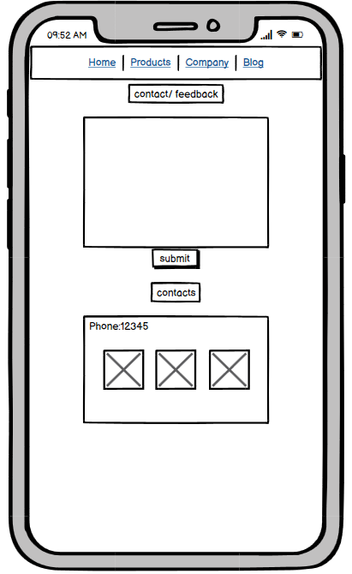
Contacts Page/ Wireframes

Slide 16
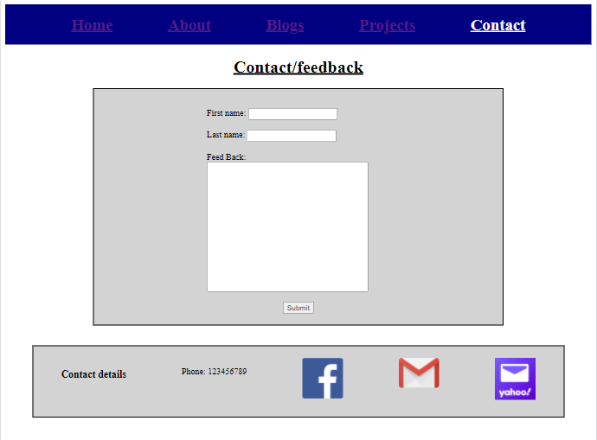
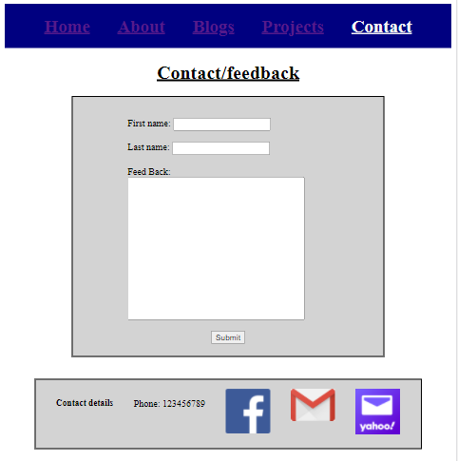
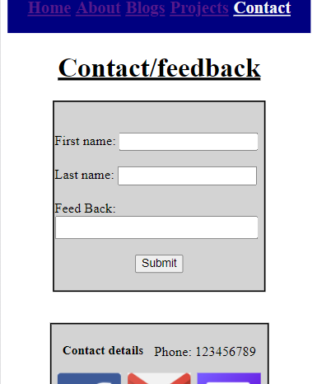
Contacts Page/ Web

Slide 17
Decision making/ Features
The contact page design
Kept it simple for easy management
The layout
2 borders to divide my links no to make it to plain
Any interesting features
img links and text boxes

Slide 18
Challenges/ What I Enjoyed
Challenges I faced while create my website
Padding, bad habit’s, messy/unorganised code
Link active, link hover and link color constant battle
Nav bar fixed issues

Slide 19
Questions?
Any comments to add or constructive criticism

Slide 20
Thank You

